Slide 1

The Oracle of DSCOVR
GEM: Geomagnetic Event Monitoring
Team TAITATUMU
Chao-Sheng Hung
Wei-Yi Hsu
Guan-Yong Xiong
Hung-Yi Chen
Hoi-Lam Lou

Slide 2

What we do
Prediction
01
Continuously predicting solar storm’s occurrence and duration
Handling Anomalous Data
02
Addressing DSCOVR abnormal data, as to prevent data wastage
What we do
Model Framework
Approaches
Results
Highlights

Slide 3
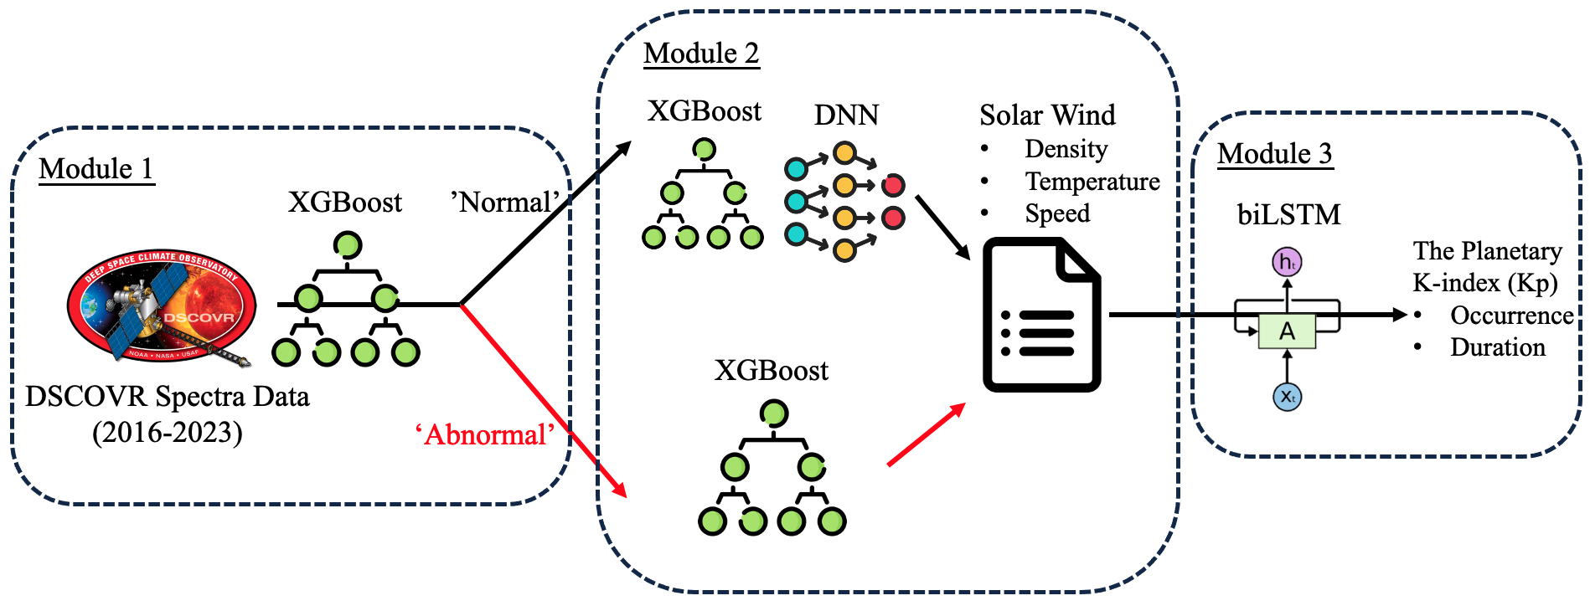
Model Framework
Mainly consists of 3 modules, which highlights the classification of anomalies in Module 1, ensuring that the anomalies in DSCOVR are not wasted.
What we do
Model Framework
Approaches
Results
Highlights

Slide 4
Approaches
From Space Data:
DSCOVR Magnetic Field and Spectrum Data Sets
DSCOVR Faraday Cup Level 2 Data
OMNI Geomagnetic Activity Indices
Module 2 Training
Modules Integration
Train an AI model to map DSCOVR spectral data to its level 2 solar wind properties using data from 2016-2020.
Identify data from 2021-2023 as 'abnormal' values if they deviate significantly from our predictions.
Integrate all the modules to predict Kp from spectral data and determine the occurrence and duration of geomagnetic storms.
02
04
01
03
Data Preparation
Module 1, 3 Training
Resampling to a consistent time scale
Cropping the sequence data
Handling missing values
Data range scaling
Train an AI model to classify DSCOVR spectral data as ‘normal’ and ‘abnormal’ in module 1.
Train an AI model to map DSCOVR level 2 data into planetary K-index for module 3.
What we do
Model Framework
Approaches
Results
Highlights

Slide 5
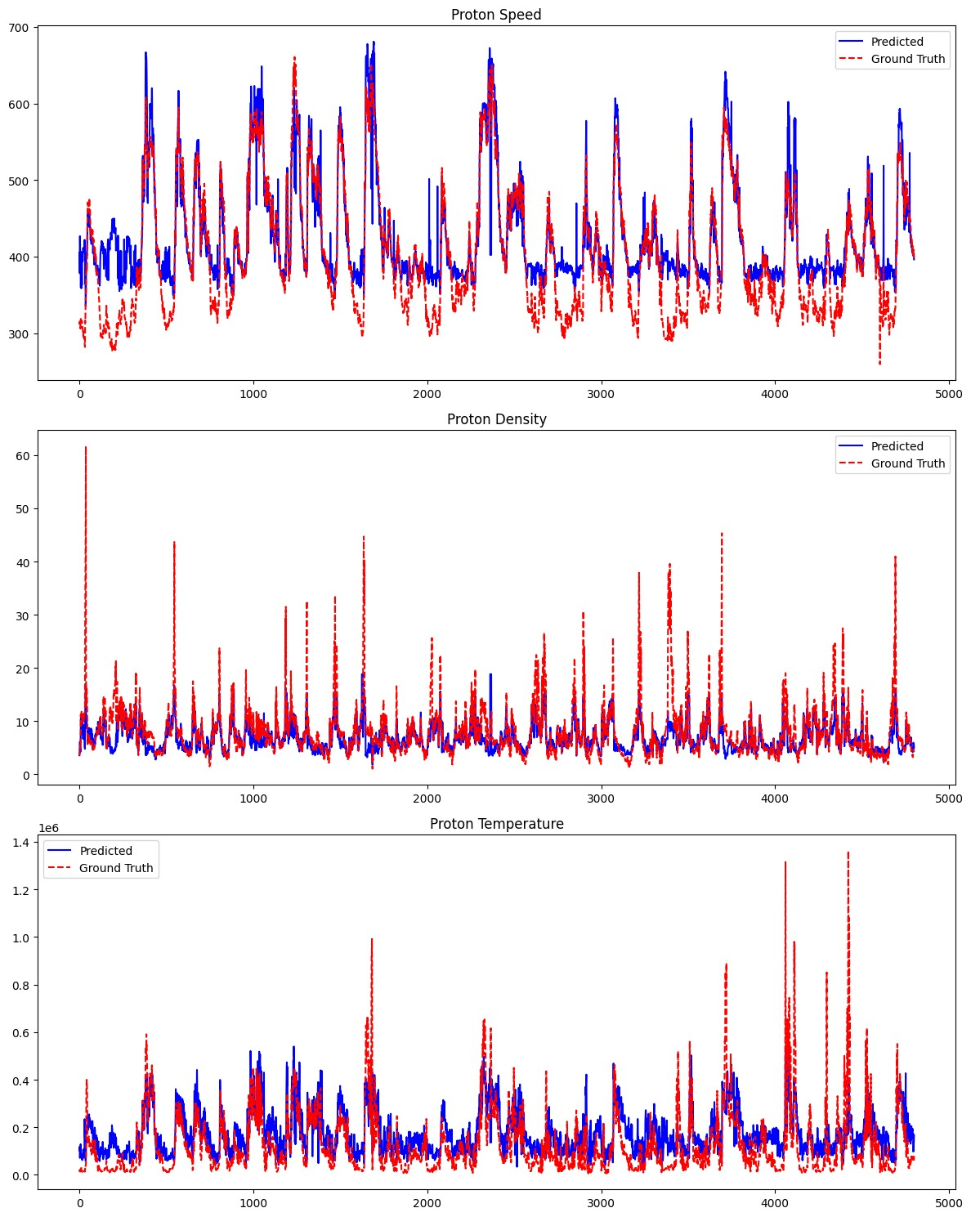
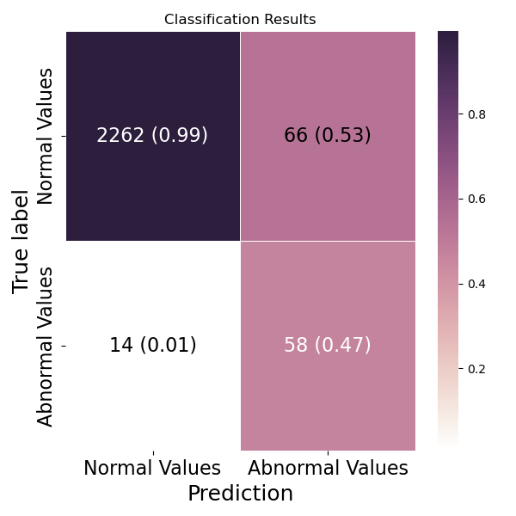
Results
Performance on module 1:
Accuracy: 0.9671
Precision of 0.4715
Recall of 0.8056
Performance on module 2:
RMSE: 0.4062
MAE: 0.2792
R-squared: 0.9960
What we do
Model Framework
Approaches
Results
Highlights
`

Slide 6
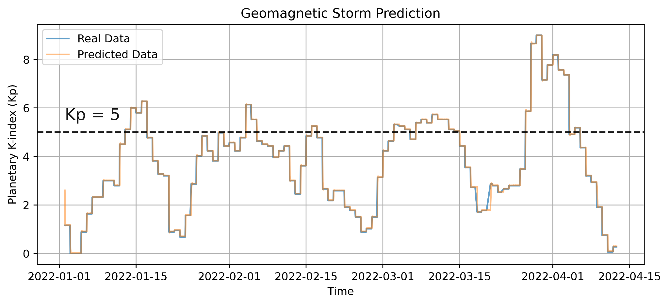
Results
Following the outputs from the first two modules, biLSTM model in module 3 performs well in predicting Kp with an R2 score of 0.9907, providing a reliable forecast indicator for geomagnetic storm occurrence.
What we do
What we do
Model Framework
Model Framework
Approaches
Approaches
Results
Results
Highlights
Highlights
`

Slide 7
Highlights
The proposed prediction workflow can effectively forecast geomagnetic storms.
The workflow can serve as a backbone solution, addressing similar issues such as anomaly detection by adjusting inputs and outputs based on domain knowledge.
The individual models within the three modules of the main task can be applied to various types of tasks, such as anomaly classification, numerical prediction, and time series data forecasting.
What we do
What we do
Model Framework
Model Framework
Approaches
Approaches
Results
Results
Highlights
Highlights
`

